Slide 1

Novartis Corporation
Your 2025 Delta Dental Plans

Slide 2


Getting the most from your Delta Dental benefits
Available networks
Your dental plan
Benefit enhancements:
  Integrated Care Enhancement
  Oral Health Enhancement
  Special Health Care Needs benefit
  Virtual Visits
Member experience
ID cards
Contact Delta Dental
Oral health information
Throughout this deck, this symbol indicates clickable links or screenshots on a page. Click on a topic on this slide and you will be link directly to the corresponding chapter.

Slide 3
Nationwide networks

Slide 4

Delta Dental PPO Plus Premier™ nationwide networks
If you use a….
Delta Dental PPO™ dentist
Delta Dental Premier® dentist
Non-participating dentist
Large choice of network providers
Dentist’s fees are capped, so your annual maximum stretches farther
Lowest out-of-pocket cost
No hassle! Dentists are paid directly by Delta Dental
Largest choice of network providers
Dentist fees are capped, but not as discounted as PPO dentists, so your annual plan maximum will not go as far
Slightly higher out-of-pocket cost
No hassle! Dentists are paid directly by Delta Dental
Freedom to choose
Highest out-of-pocket cost
You are responsible for submitting the claim form
You are responsible for making payments to
the dentist
Need a dentist? Visit www.DeltaDentalNJ.com/Novartis (click on Find a PPO Plus Premier Dentist)

Slide 5
Delta Dental PPO Plus Premier Network
AT A GLANCE EXAMPLES
Choosing an in-network dentist saves you money. For example:
Regular Preventive and Diagnostic Visit
 | Dentist’s charge | Sample Delta Dental fees | Member Co-Insurance | Delta Dental pays | Balance billed amount | Amount you pay out of pocket
PPO Network | $262 | $140 | 0% | $140 | $0 | $0
Premier Network | $262 | $160 | 0% | $160 | $0 | $0
For illustrative purposes only. Fees vary by procedure and location. Illustration assumes 100% coverage for P&D.
Your out-of-pocket savings are even more significant when you choose a PPO specialist, like in this example:
Getting a Crown
 | Dentist’s charge | Sample Delta Dental fees | Member Co-Insurance | Delta Dental pays | Balance billed amount | Amount you pay out of pocket
PPO Network | $1,714 | $790 | 40% | $474 | $0 | $316 ($790 - $474)
Premier Network | $1,714 | $930 | 40% | $558 | $0 | $372 ($930 - $558)
For illustrative purposes only (based on NJ zip code). Fees vary by procedure and location.

Slide 6
Your dental plan

Slide 7
Dental Summary Novartis Corporation – Group Number 09776 | In-Network Dentists Delta Dental PPO Plus PremierTM | Out of Network Dentists
Annual Deductible (waived for Preventive & Diagnostic Services) Per person Family aggregate deductible | $50 $150 | $100 $300
Annual Maximum (per person) | $2,000 | $2,000
Preventive & Diagnostic Services Exams, Cleanings, Bitewing X-Rays Fluoride Treatment, Sealants Full Mouth X-Rays | 100% Covered | 100% Covered
Remaining Basic Services Fillings, Simple Extractions Root Canals (Endodontics), Periodontics Space Maintainers, Repair of Dentures | 80% Covered | 80% Covered
Major Services Crowns & Crown-Related Procedures Bridgework, Full & Partial Dentures Oral Surgery, Implants | 60% Covered | 50% Covered
Periodontal Surgery (per person) Coinsurance Annual Maximum | 80% Covered Unlimited | 80% Covered Unlimited
TMJ Services (Temporomandibular Joint) Coinsurance Lifetime TMJ Maximum | 50% Covered $1,500 | 50% Covered $1,500
Orthodontic Benefits (Adult & Children) Coinsurance Lifetime maximum – per patient | 50% Covered $2,000 | 50% Covered $2,000
Sales plugs in details here
This overview contains a general description of your dental care program for your use as a convenient reference. Complete details of your program appear in the group contract between your plan sponsor and Delta Dental of New Jersey, Inc.

Slide 8
Benefit enhancements
For your PPO / PPO Plus Premier Plan
Notes:
• Divider pages are 100% Delta Dental Green
• Divider page titles should be limited to one line
• Only the first word in titles should be capitalized
• Subtitle is used to expand on the title and can be up to 3 lines
• Only the first word in subtitles should be capitalized

Slide 9

Integrated Oral Health Enhancement (IOH)
Who is eligible for the IOH enhancement?
Members who have been diagnosed qualifying systemic health conditions (i.e., diabetes, heart disease, and pregnancy).
Members who are or become pregnant; IOH applies
during the course of the pregnancy until delivery.
How does IOH help members?
Allows up to two extra routine dental cleanings and/or
periodontal maintenance procedures per benefit period (for a total of four).
What do you need to do?
Ask your provider to complete and sign an
Integrated Oral Health Qualification form.

Slide 10
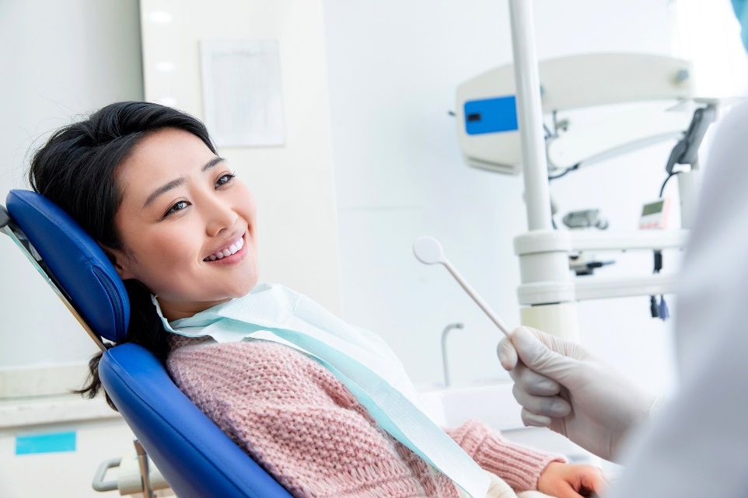
Oral Health Enhancement (OHE)
Who is eligible for OHE?
Members with a history of periodontal (gum) surgery or scaling and root planning.
How does the OHE help members?
Allows up to two extra routine dental cleanings and/or periodontal maintenance procedures per benefit period (up to a total of four).
What do you need to do?
Your dentist will need to submit evidence of your history of having periodontal surgery or scaling and root planning. Or have your dentist complete our Oral Health Enhancement Qualification form.

Slide 11

Special Health Care Needs benefit
Who qualifies for this benefit?
Covered members (children and adults) with a qualifying special health care need.
How does this help Special Health Care needs patients?
Additional dental examinations and/or consultations.
Up to four total dental cleanings in a benefit year.
Coverage for anesthesia and nitrous oxide.
What do you need to do?
Please share the Special Health Care Needs flyer with your dentist.
Call Delta Dental Customer Service at
800-543-0584.
For the 6.5 million people of all ages in the U.S. with intellectual or developmental disabilities, oral health care can be inaccessible or overwhelming.
Delta Dental is changing that.

Slide 12



Dental emergency? Use our Virtual Visits service!
Delta Dental Virtual Visits, delivered by TeleDentistry.com, provides 24/7 access to a
dentist, 365 days a year, for our members.
You can use Delta Dental Virtual Visits when:
having a dental emergency while on vacation,
during holidays, or away from home
needing access to a licensed dentist after hours
or if your dentist is unavailable
having a dental emergency and you do not
have an established dentist
Visit: DeltaDentalNJ.com/VirtualVisits
Call: (866) 443-1882
Always try to access your regular dentist before using this service.

Slide 13
Member experience

Slide 14

Delta Dental ID card
A welcome letter including two copies of your ID card will be mailed to your home address prior to January 1, 2025.
As of January 1st, you may download your
ID card from our mobile-friendly website by registering at www.DeltaDentalNJ.com/Novartis in our MySmile portal.
From our mobile app*, you can also email this card or even save it to your Apple Wallet.
* To download Delta Dental’s mobile app on your device, visit the App Store (Apple) or Google Play (Android) and search for Delta Dental.

Slide 15



Your MySmile® account has it all
Watch these handy videos:
Navigating the website
Your Explanation of Benefits (EOB) Explained
Why it pays to stay in network
Easy-to-use dashboard to navigate your benefits:
View your coverage details
Check your dental claims
View and print your ID card
Review your treatment history
Find the right dentist for you
Get accurate estimates and more
Two simple ways to register for and then access MySmile®:
  DeltaDentalNJ.com/Novartis
Delta Dental Mobile App
Use the same log in for both the website and app.
The subscriber and any adult dependents on the plan can create their MySmile® account with or without an ID number.

Slide 16
Delta Dental contact information

Slide 17



Connecting with Delta Dental of New Jersey
  800-543-0584
  8:00 a.m. - 6:30 p.m. EST Mon. – Thurs.
  8:00 a.m. - 5:00 p.m. EST Fri.
  Email us
  DeltaDentalNJ.com/Novartis
Novartis Corporation
Your group number is
09776
Delta Dental Mobile App

Slide 18
Oral health information

Slide 19
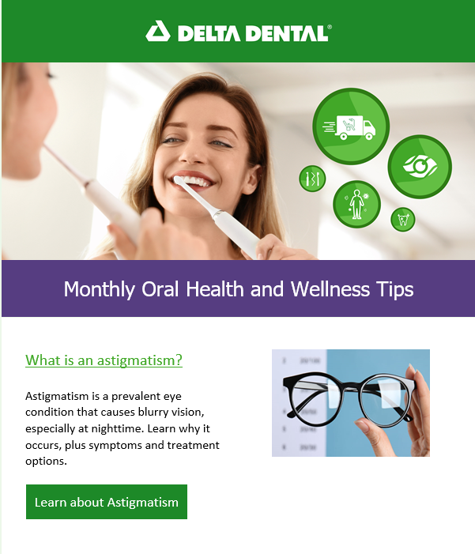
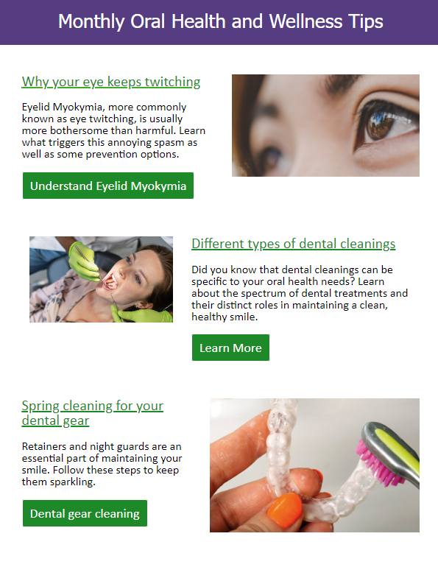
Educational member resources
Dental Central
Oral health library
Captain Supertooth
grin! Magazine
MyDentalScore.com
Wellness articles

Slide 20
Questions?
Log into your MySmile® portal
or
Contact us at 800-543-0584

