Slide 1
MySmile Usage Report
Group Name – Group Number
Presented Date

Slide 2
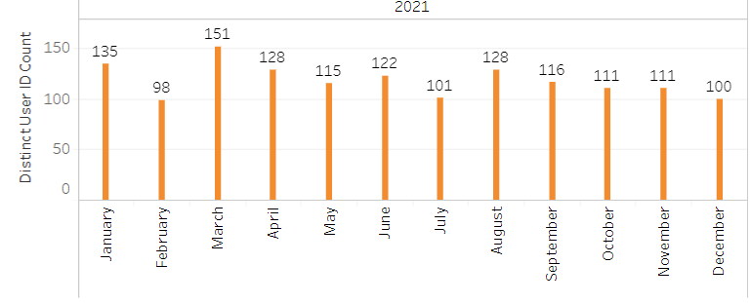
3,909* registered XYZ subscribers on MySmile since August 2019
15% of XYZ subscribers have registered on MySmile since August 2019
1,419 MySmile accounts registered in 2021
* As of date report was ran

Slide 3
55% of registered MySmile users have opted into paperless
Total XYZ subscribers | 26,770
Enrolled on MySmile (August 2019 – January 18, 2022) | 3,909 | 15% of subscribers enrolled on MySmile
Elected paperless EOBs/PTEs (August 2019 – January 18, 2022) | 2,145 | 55% of MySmile registered users are paperless

